Slide 1

SOFTWARE ENGINEERING
More on Software Architecture by Prof. Mohamad Kassab
Leonidas Kontothanassis kthanasi@bu.edu

Slide 2
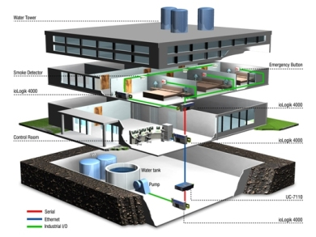
Building Automation System (BAS) – Case Study

Slide 3
Architectural Drivers
Architectural drivers are requirements that will shape the software architecture
Architectural drivers include:
Software
Architecture
Functional Requirements
Quality Attributes
Constraints

Slide 4
Architectural Drivers
Architectural Drivers for the Building Automation System
# | Architectural Driver | Priority
1 | Support for adding new field device | (H, H)
2 | International language support | (H, M)
3 | Non-standard unit support | (H, M)
4 | Latency of alarm propagation | (H, H)
5 | Load conditions | (H, H)
Notes:
What is an architecture driver: Any requirement/constraint that has a significant impact on the architecture of the system
Most functional requirements do not affect the architecture of the system, while most non-functional ones do.
Examples:
Functional requirement: System must process payments in multiple currencies and multiple languages
Non-functional requirements: Almost anything you can think of
Constraints: Must run on XXX platform
Business constraint: Must ship in XXX months under YYY dollars
Priority has 2 parts, business value, technical risk. When designing architecture start with high value and high technical risk. (H, M, L)

Slide 5
ADD Method
The Attribute-Driven Design (ADD) method (Bass et al., 2003), developed at the SEI, is one approach to defining software architectures by basing the design process on the quality attribute requirements.
In ADD, architectural design follows a recursive decomposition process where, at each stage in the decomposition, architectural patterns and tactics are chosen to satisfy a set of quality attribute scenarios .
The architecture designed represents the high-level design choices which are documented using multiple structures or views (we introduced these terms in an earlier lesson).
The nature of the project determines the views.
Notes:
Hierarchical, layered design.

Slide 6
ADD Inputs and Outputs
Requirements
Functional
Quality
Constraints
ADD Process
Containers
Responsibilities
Interactions
Information flow

Slide 7
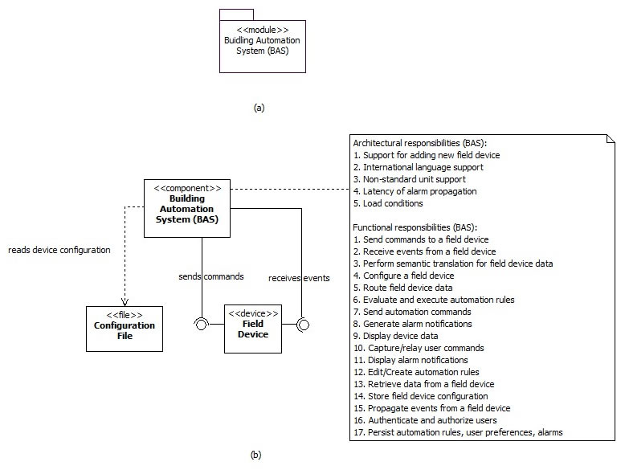
Building Automation System
We start with a monolithic system as shown in this slide.
Notes:
This is a very coarse breakdown.

Slide 8
Building Automation System
Initially the monolith, being the only system component, is responsible for all functionality to be implemented along with satisfying all the architectural drivers.
Obviously, the monolithic structure can’t satisfy most of these architectural drivers and we use ADD to decompose it further until all of these drivers are satisfied.
We begin with one of our highest priority architectural driver 1 (support for adding new field device).

Slide 9
Architectural Driver 1
ADD applies the modifiability tactics to limit the impact of change and minimize the number of dependencies on the part of the system responsible for integrating new hardware devices.
There are three design concerns related with modifiability:
Localize changes: this relates to adding a new field device
Prevention of ripple effects: this relates to minimizing the number of modules affected as a result of adding a new field device
Defer binding time: this relates to the time when a new field device is deployed and the ability of non-programmers to manage such deployment

Slide 10
Architectural Driver 1
We address these concerns by creating adaptors for field devices, an anticipation of expected changes tactic.
We use two additional architectural tactics to minimize propagation of change.
First we specify a standard interface to be exposed by all adaptors (maintain existing interfaces).
Second, we use the adaptor as an intermediary responsible for semantic translation into a standard format, of all the data received from different field devices.
As a side effect, this also addresses architectural driver 3.
Notes:
Maybe speak about OpenFlow as an example of industry wide common adaptors. Reference back to slide 12 for the architectural drivers.

Slide 11
Architectural Driver 1
The adaptors are assigned the following responsibilities:
Send commands to the field device
Receive events from field device
Perform semantic translation for field device data

Slide 12
Architectural Drivers 1 & 3
Instantiating and allocating responsibilities to the adaptors leads to a realization that the building automation server is still sensitive to a change in the number of field devices it is connected to, and must include logic to route commands and data, to and from the correct adaptor.
To address this concern we use the hiding information tactic introducing an adaptor manager to hide information about the number and type of field devices actually connected.
The adaptor manager together with the adaptors creates a virtual device, that is, for all other components of the building automation system, there is practically one field device to interact with at all times.
Notes:
In order to avoid having the main system know about all adaptors, we introduce adaptor manager.

Slide 13
Architectural Drivers 1 & 3
Additionally, the adaptor manager uses the following two architectural tactics to address the defer binding time design concern
Runtime registration: this will support plug-and-play operation allowing non-programmers to deploy new field systems.
Configuration files: this tactic enables setting of configuration parameters (such as initial property values) for the field systems at startup.
Notes:
If new device has no defaults, what is the right response?

Slide 14
Architectural Drivers 1 & 3
The adaptor manager is assigned the following responsibilities:
(FR4) Route data to a field device

Slide 15
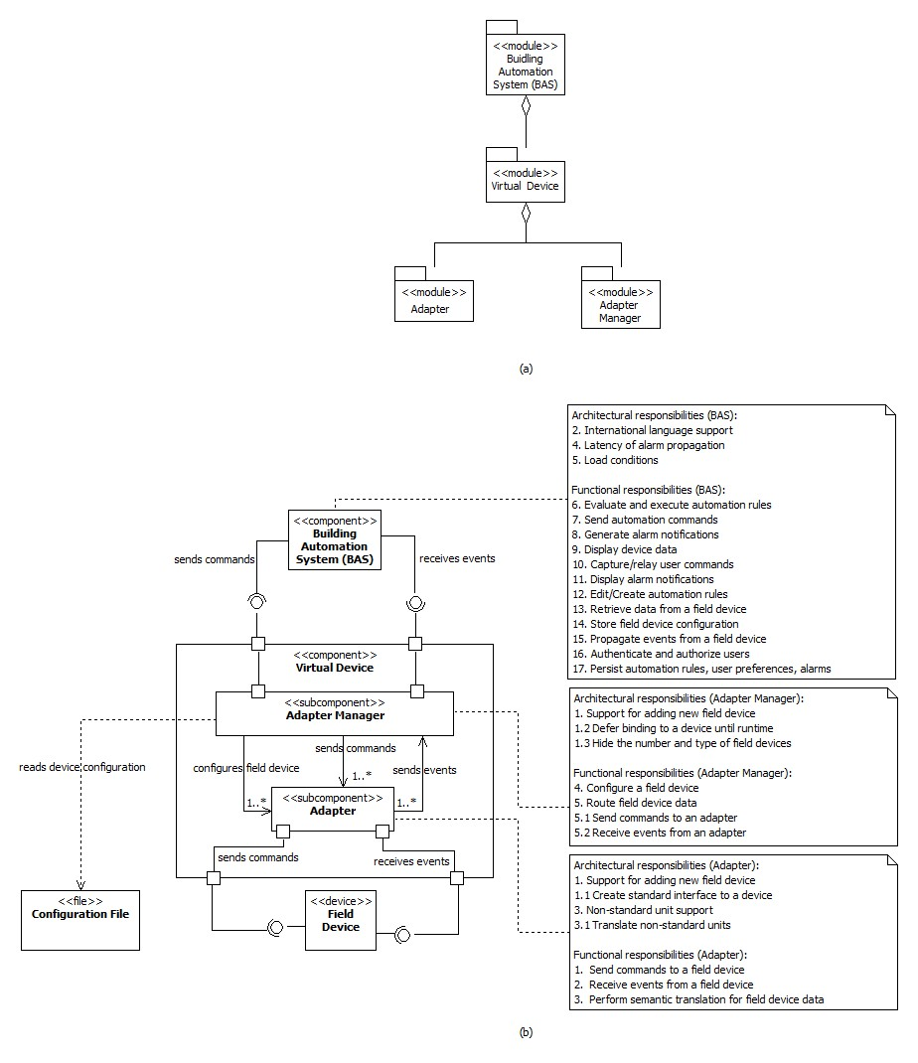
Notes:
Earlier system further decomposed.

Slide 16
Architectural Driver 5
We next consider architectural drivers 5 related to the performance quality attribute of the Building Automation System and we also consider performance constraints.

Slide 17
Architectural Driver 5
There are two design concerns related to these drivers:
Resource Demand: the arrival of change of property value events from the various field devices and the evaluation of automation rules in response to these events are source of resource demand
Resource Management: the demand on resources may have to manage in order to reduce the latency of event and alarm propagation
Notes:
This could be sharded by dividing the evaluation of rules on multiple servers, at the cost of data from sensors being copied to multiple places.

Slide 18
Architectural Driver 5
To address these concerns, we move the responsibility of rule evaluation and execution, and alarm generation, respectively to a separate Logic & Reaction (L&R) component and an Alarm component.
These components running outside the automation server can now be easily moved to dedicated execution nodes if necessary.
In doing so, we are making use of the increase available resources tactic to address the resource management concern and the reduce computational overhead tactic to address the resource demand concern.
We use an additional tactic to address the resource management concern. This tactic relies on introducing concurrency to reduce delays in processing time.
Concurrency is used inside the L&R and Alarm components to perform simultaneous rule evaluations.

Slide 19
Architectural Driver 5
We assign the following responsibilities to the L&R and Alarm components:
Evaluate and execute automation rules
Send automation commands
In addition, we assign the following responsibility to the Alarm component:
Generate alarm notifications

Slide 20
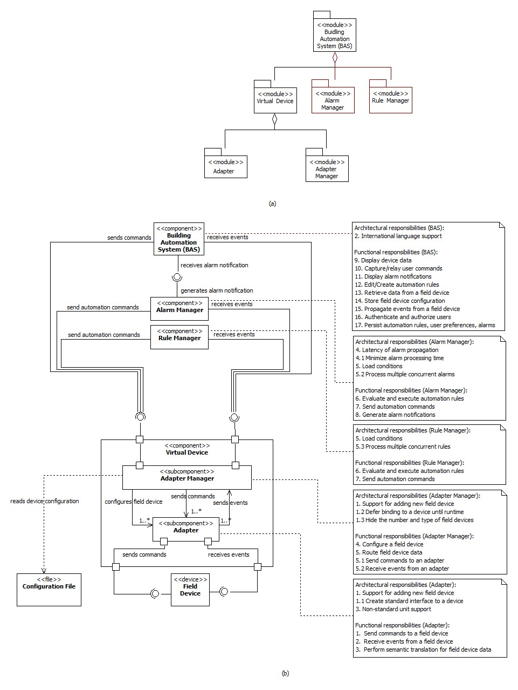

Slide 21

And the process goes on …

Slide 22


Readings , Assignments, Project Tasks
Read:
Chapter 10
Assignments & Project Tasks (Upcoming three items):
Your final presentations are already scheduled Tuesday (6/5), Thursday (8/5).
Project Deliverable 5 package is due on Friday (9/5)

